Slide 1
CBF Overview
Date

Slide 2
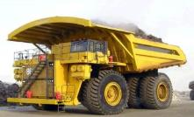
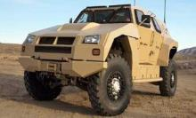
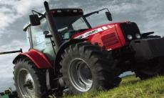
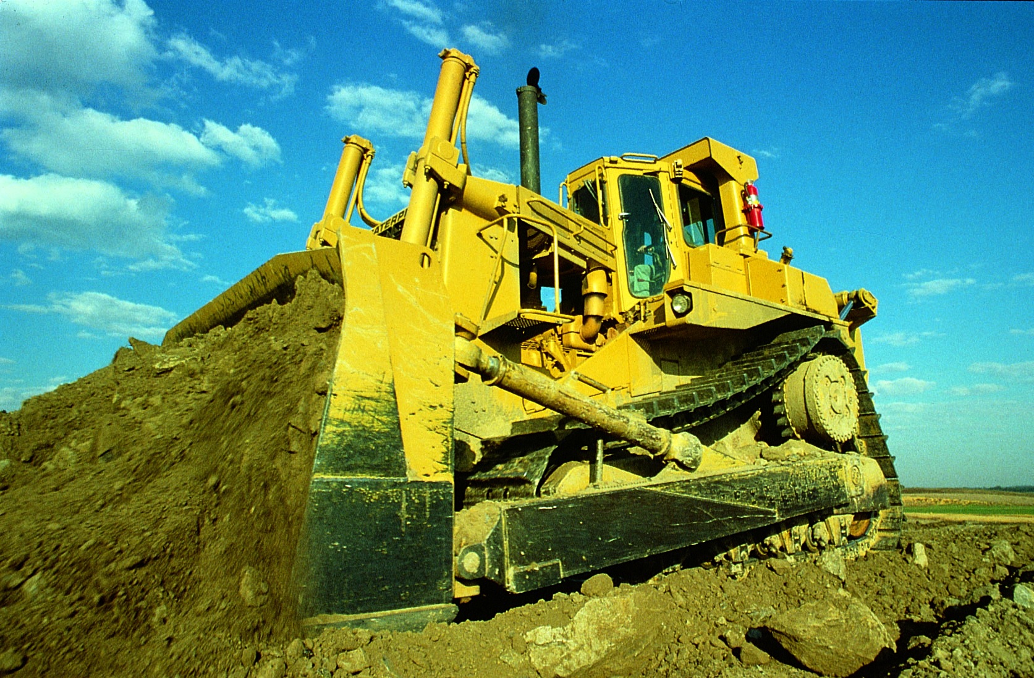
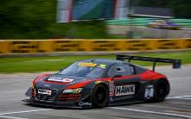

Agenda
Carlisle Companies
CBF Introduction
  Facilities
  Sales by Market
  Customers Brands
  Value Proposition
  Capabilities and Experience
  Markets and Products

Slide 3

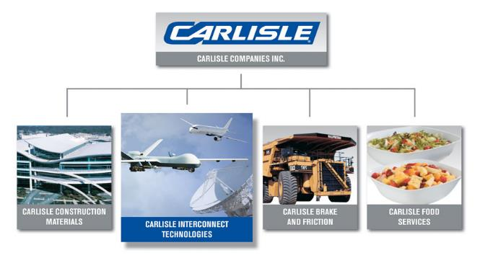
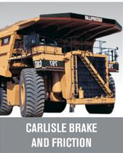



Carlisle Companies (NYSE:CSL)
Overview
Diversified Manufacturing Conglomerate
Headquartered in Charlotte, NC
2014 Revenues: $3.2 billion
Public Company (CSL on NYSE)
CARLISLE CONSTRUCTION MATERIALS
CARLISLE INTERCONNECT TECHNOLOGIES
CARLISLE FOOD
SERVICES
CARLISLE FLUID TECHNOLOGIES
CARLISLE BRAKE & FRICTION

Slide 4




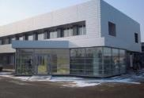
Carlisle Brake & Friction
“Carlisle Brake & Friction is the first choice in innovative braking and friction solutions for the world’s top manufacturers. Our global manufacturing, sales and support networks ensure we are there to serve and support our customer base, wherever they may be.”
Matt Dietrich, President CBF
CBF Quick Facts
Global Headquarters: Solon, Ohio
R&D Centers: Solon, Ohio; Bloomington, Indiana; Pontypool, Wales; Suzhou, China; Orzinuovi, Italy
Manufacturing Facilities: U.S., China, Italy, Japan, Wales, India
Additional Sales Offices: Russia, Australia, Netherlands
Employees: More than 1,700 Worldwide
Experience: More than 85 Years

Slide 5




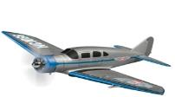




Carlisle Brake & Friction Heritage
Began production of transmission linings for the Ford Model “T”.
Produced first
sintered metallic friction for tanks.
Licensed Frendo-Abex in Italy and built new plant.
Acquired BF Goodrich off-highway brake division.
Acquired Meritor off-highway brake division.
1920
1930
1940
1950
1960
1970
1980
1990
2000
2010
2010
First use of sintered metal brake discs in Goodyear airplane brakes.
Supplied brakes for the first generation of CAT mining trucks.
Introduced paper friction for heavy-duty applications.
Among the first group of suppliers approved by the CAT quality audit team.
Aquired Hawk/ Wellman Products Group.

Slide 6





Global Capabilities - Facilities
 | Area (Sq. Ft) | Products | Primary Markets
World Headquarters Solon, OH | 58,000 | Sales, Marketing, Customer Service, R&D Center | Global Market Management
CBF - Friction Products Medina, OH | 219,000 | Organic, Metallic, Paper, Steel, Semi-Metallic | Aerospace, Agriculture, Construction, Truck, Motorsports, Powersports, Military
CBF – Friction Products Tulsa, OK | 240,000 | Metallic, Graphitic, Steel, Stampings | Construction, Truck, Agriculture, Military
CBF - Friction Products Orzinouvi, Italy | 106,000 | Graphitic, Metallic, Organic, Paper, Steel. Stampings | Agriculture, Construction
CBF – Friction Products Suzhou, China | 73,000 | Metallic, Organic, Paper, Steel | Agriculture, Construction
CBF – Brake Products Bloomington, IN | 250,000 | Dry Caliper Disc Brake, Friction Products, Hydraulic Actuation Systems | Mining, Construction, Military, Alternative Energy, Industrial
CBF – Hydraulics & Actuation Pontypool, Whales | 50,000 | Boosters, Master Cylinder, Ball on Ramp brake components | Agricultural, Construction
CBF – Brake Products Hangzhou, China | 144,990 | Machining and Assembly | Mining, Construction, Industrial, On-Highway
CBF - Hydraulics & Actuation Chennai, India | 18,000 | Master Cylinder, Ball & Ramp Brakes | Agriculture
CBF – Japan Power Brake Atsugi, Japan |  | Dry Caliper Brakes, Hydraulic Actuation, Disc Brake Pads, and Wet Friction | Mining, Construction, Agriculture and Industrial

Slide 7
CBF Markets

Slide 8






























Blue Chip Customers

Slide 9
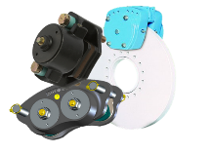
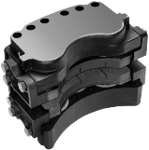
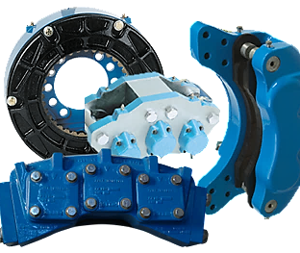
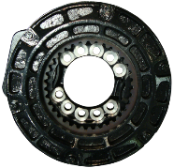
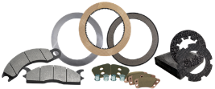
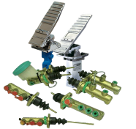
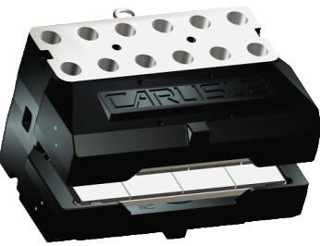
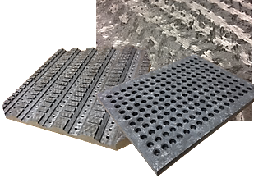
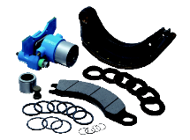
Brake System Solutions
Park and Emergency Brakes
Combination - Park and Service Brakes
Service Brakes
Drum Brakes
Wet and Dry Friction Material
Hydraulic Control Products
Turbine – Yaw and Rotor Brakes
Carbon/ Carbon Composite
Spare Parts

Slide 10






Brands
Dry Caliper Brakes (Park and Service), Hydraulic Actuation, and Disc Brake Pads
Dry Caliper Brakes (Park and Service), Hydraulic Actuation, Disc Brake Pads, and Wet Friction
Disc Brake Pads, Disc Brake Rotors, Clutch Discs
Friction Materials for Clutch, Dry and Wet Brake, and Transmission
On-Highway & Off-Highway Disc Brake Pads, Transmission, Clutch, Wet Brake and Industrial and Specialty
Composite materials for Powdered Metal and Metal Injection Molding Sintering Trays, Atmosphere and Vacuum Furnaces, High-Temp Fasteners, Racing Brakes, Racing Clutches and Energy Production

Slide 11

Value Proposition
FULL SYSTEM SOLUTIONS
From the Pedal to the Wheel
ADVANCED ENGINEERING
Advanced Application Knowledge, Innovative Products & Technologies
EXPERIENCE
Reliable Supplier to World-class OEMs for Over 85 Years
GLOBAL CAPABILITIES
Engineering, Manufacturing & Sales Support in Asia, the Americas & EMEA
SUPERIOR MATERIAL TECHNOLOGY
Broadest Range of Material Competencies, Brake & Friction Innovation
CUSTOMER CENTRIC
Dedicated to the Success of our Customers

Slide 12

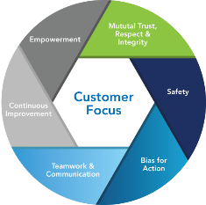
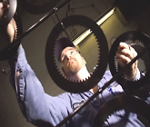
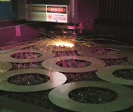
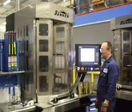
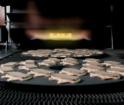
Manufacturing Excellence
Manufacturing Excellence
  Automated and semi-automated production lines.
  Dedicated cell production.
  Component assembly & testing capability.
  Lean manufacturing fully implemented.
  Diverse manufacturing processes
Process Controls
Incoming Quality Controls
Dimensional Controls
Raw Material Controls
Machining Process Controls
Assembly Process Controls
Global Standardization
ISO 9001, ISO 14001, ISO/TS16949
Commitment to LEAN Culture
  COS generates continuous process and quality improvement
    Carlisle Operating System (COS) is a process of employees creatively working together to maximize performance and eliminate waste in order to drive exceptional value for our customers and shareholders

Slide 13
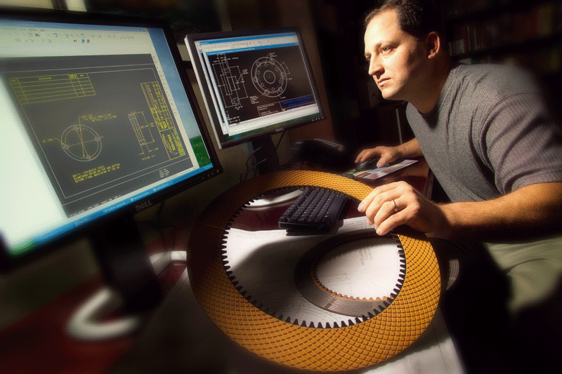
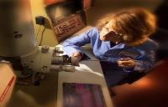
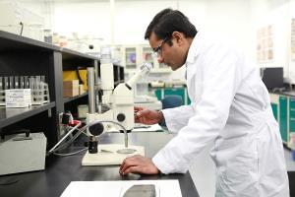
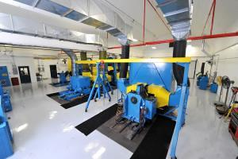
Engineering Capabilities
Value-Added Services
Research & Development
25 inertia dynamometers
70+ engineers and material scientists
R&D capabilities in each manufacturing facility worldwide
40+ year active database of test results
Long-term relationships with leading raw material suppliers
Staff of experts - Collectively bring more than a century of brake & friction experience
Testing results determine solutions for customers
State-of-the-Art Technology
New Analytical Lab
Scanning Electron Microscope
Polarizing Light Microscope
FTIR
Thermal Conductivity Meter
Innovative Lab Equipment
Hot Pressing Machine
Hand Sheet Press
New Paper Lab
Advanced Testing Capabilities
Dyno Control Upgrades
Paper Fatigue Tester

Slide 14
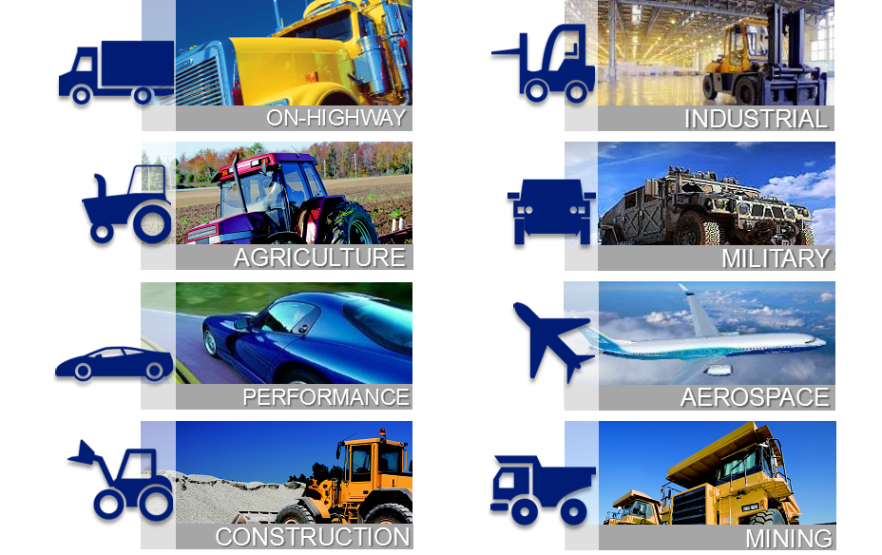
Markets & Applications

Slide 15

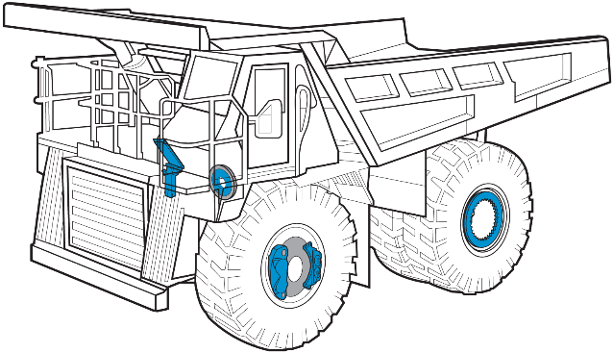





Mining
Brake and Friction Solutions
Applications: All forms of equipment used in Mining & Earth Moving markets
Wet Friction
Park & Emergency
Service Brakes
Combination Brakes
Hydraulic Control
Clutch Friction
  Mining OE Customers (Short List): Allison, Caterpillar, Komatsu, Terex & Hitachi, Liebherr, Beml, Sany

Slide 16

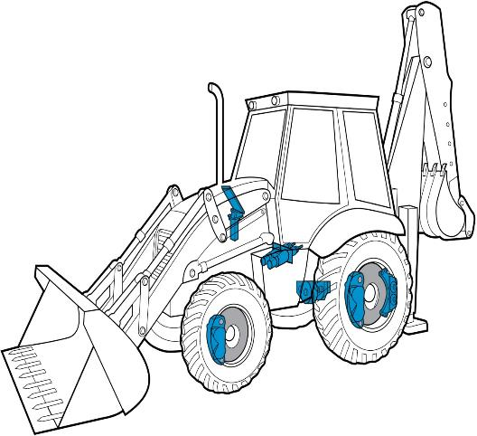

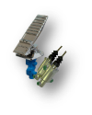



Construction
Brake and Friction Solutions
Applications: All forms of equipment used in Construction & Earth Moving markets.
Clutch Friction
Wet Friction
Hydraulic Actuation
Service Brakes
Park & Emergency
Brake Pads
  Construction OE Customers (Short List): Allison, Caterpillar, Dana, Kress, Volvo, Terex

Slide 17

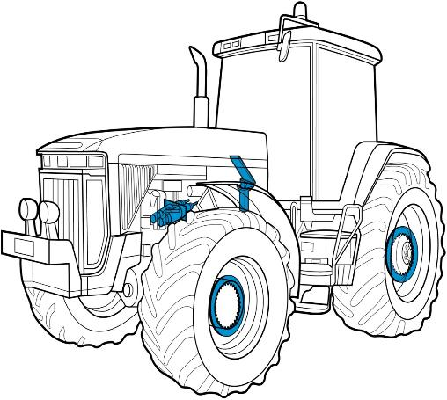




Agriculture
Brake and Friction Solutions
Applications: Equipment used in Agriculture, Forestry & Farming industries.
Wet Friction
Transmission Friction
2100 Series Valve
Master Cylinder & Boosters
Ball on Ramp Brake
Park & Emergency
  Agricultural OE Customers (Short List): Agco, Carraro, Clark Hurth, CNH, John Deere, Oxbo, Same Deutz Fahr

Slide 18
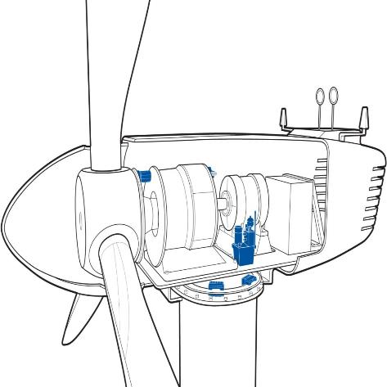

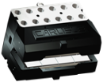
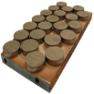

Renewable Energy
Brake and Friction Solutions
Applications: CBF offers innovative and cost-reducing features on next-generation brakes, friction and hydraulic systems for both the MegaWatt and KiloWatt class wind markets.
Rotor Brakes (KiloWatt)
Yaw & Rotor Brakes (MegaWatt)
Sintered Friction Linings
Organic Friction Linings
  Wind Turbine OE Customers (Short List):

Slide 19

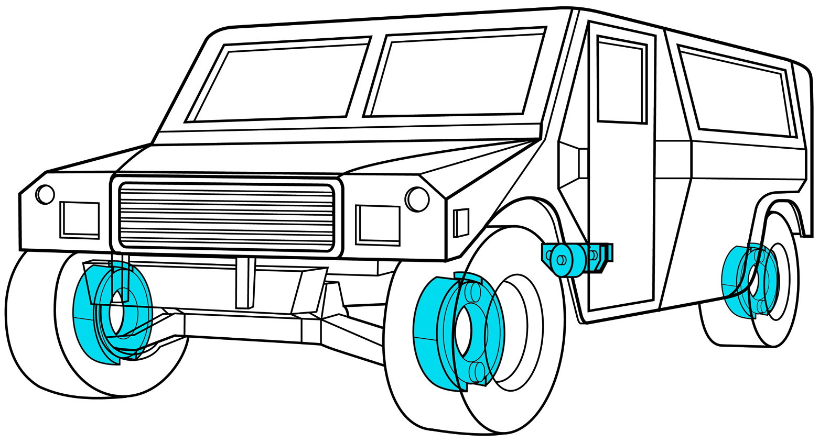





Military
Brake and Friction Solutions
Applications: Military equipment including HMMWV, Abram tank, EFV, Bradley fighting vehicle, transports, & aircraft barriers (cable brake).
Park Brakes
Service Brakes
Combination Brakes
Hydraulic Actuation
Wet & Dry Friction
Clutch Friction
  Military OE Customers (Short List): Allison, AM General, Arvin Meritor, General Dynamics, L3, Oshkosh

Slide 20

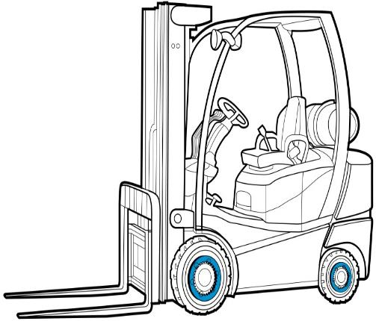



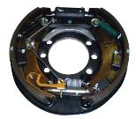


Industrial
Brake and Friction Solutions
Applications: Material Handling vehicles, Oil Rigs, Telehandlers and Cranes
Wet Brake Friction
Drum Brake
Dry Caliper Service Brake
Disc Brake Pads
Hydraulic Actuation
Clutch Friction
  Industrial OE Customers (Short List): Carraro, Clark Hurth, Crown, Eaton, Linde, Nacco, Raymond, Twin Disc, Wichita Clutch

Slide 21
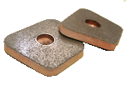
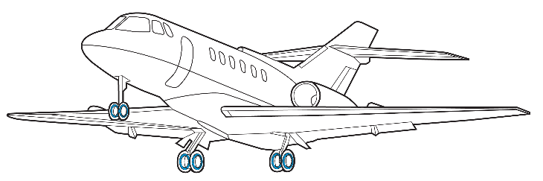
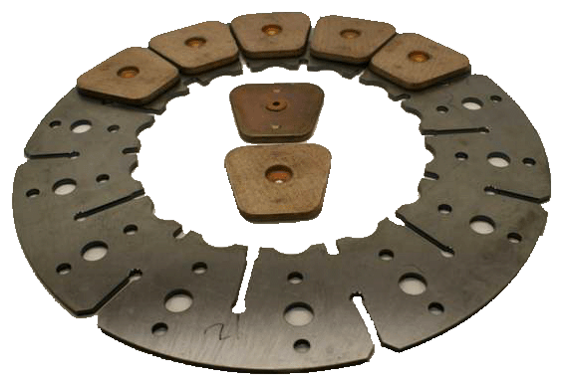
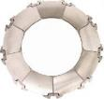
Aerospace
Brake and Friction Solutions
Applications: Commercial & Military jets, small multipurpose airliners and helicopters.
Steel Brake Rings
Steel Brake Cups
Steel Brake Insulators
  Aerospace Customers : ABS, Parker and Goodrich

Slide 22

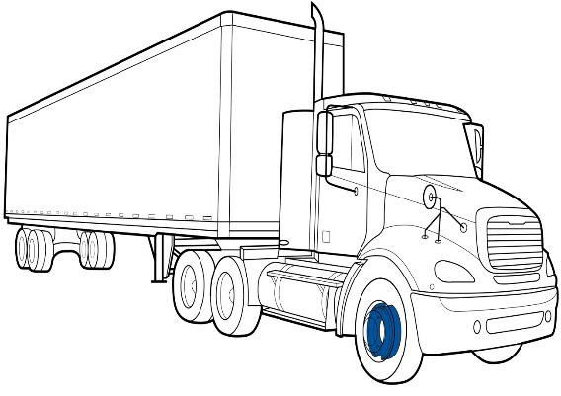




On-Highway
Brake and Friction Solutions
Applications: Class 3 – 8 Commercial Truck
Disc Brake Pads
Block Friction
Brake Shoes
Clutch Buttons
Shoe Assembly
  On-Highway OE Customers (Short List): Allison, Dana, Eaton, Horton, ZF Sachs

Slide 23
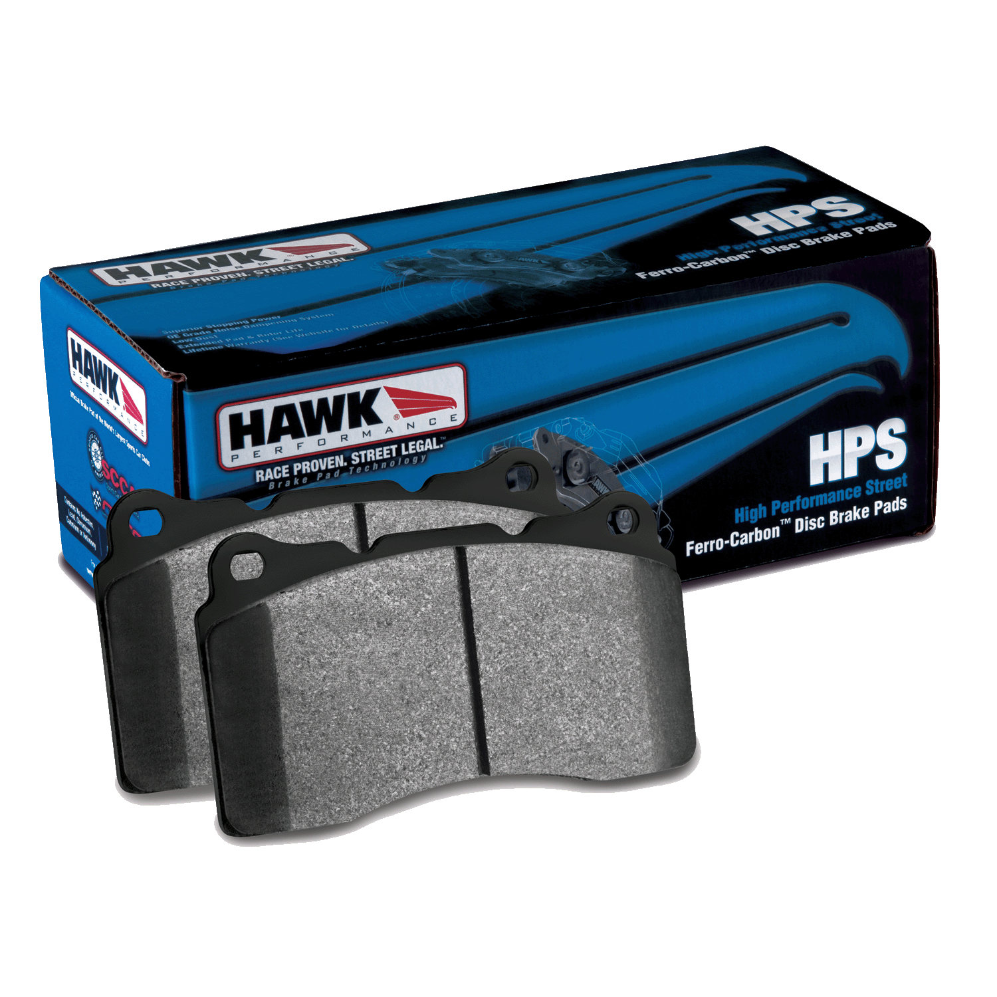
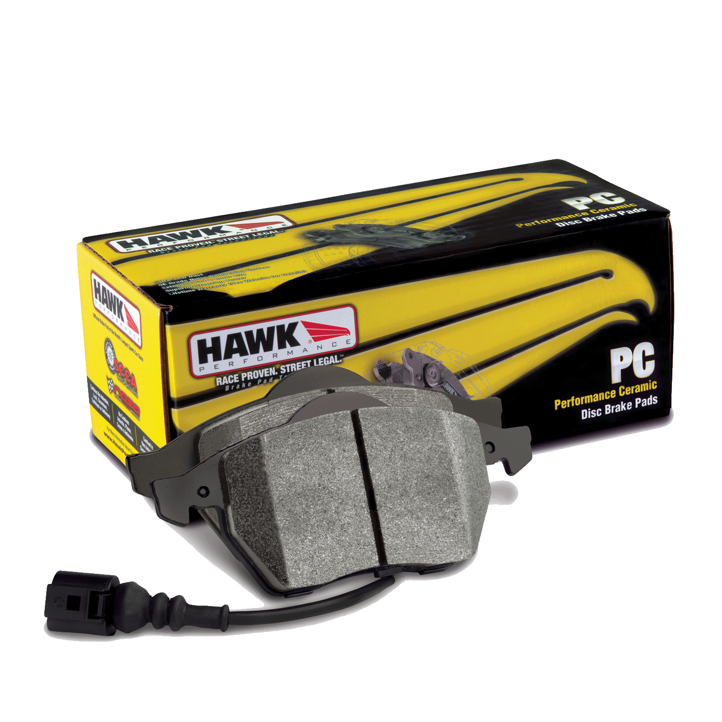
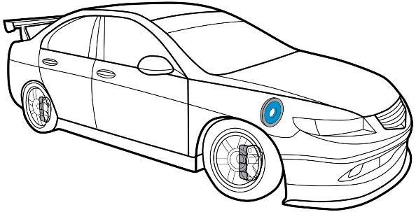
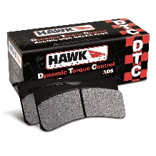





Performance Products
Brake and Friction Solutions
Applications: Import, Domestic, Sport, Luxury, Light Truck & SUV
Circle Track & Sports Car Racing
Disc Brake Pads/Street
Disc Brake Pads/ Race
Brake Rotors
Transmission Discs
Clutch Discs
Carbon
  Performance Products Customers (Short List): The Tire Rack, Brembo, Summit Racing, Hayes Brake

Slide 24
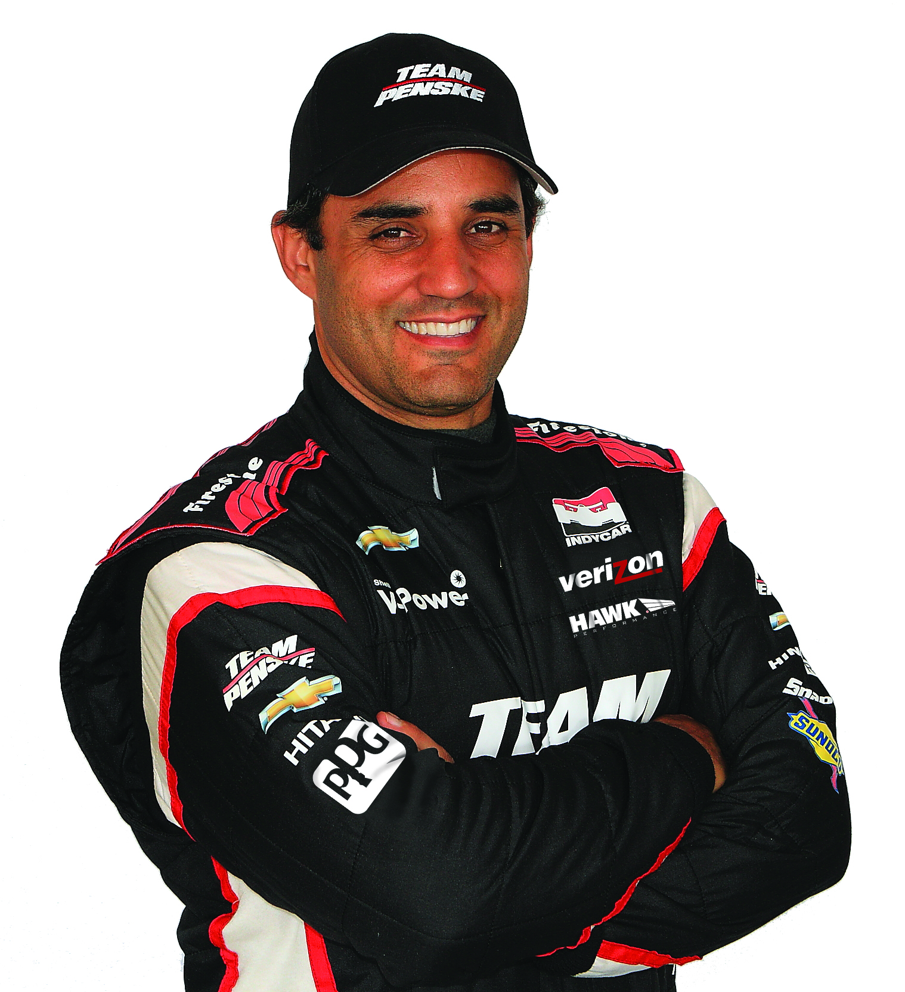
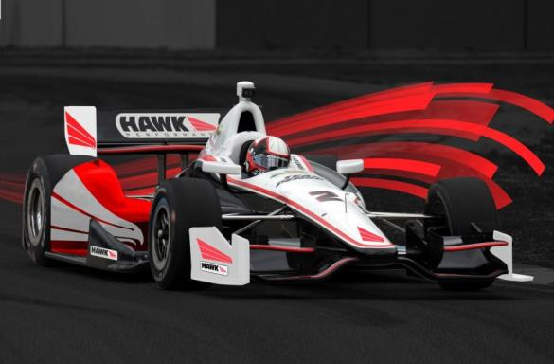

Penske Partnership
Carlisle Companies are a proud sponsor of the Team Penske Verizon IndyCar Series No. 2 car of driver Juan Pablo Montoya.

Slide 25
Thank you for your attention.
For further information please contact:
  Name
  Telephone
  Email
Or visit:
  www.carlisleCBF.com

